Slide 1
Programming Through Java Code: 502
UNIT-II

Slide 2
Contents
Inheritance
Polymorphism
Exception handling
Multithreading
I/O basics

Slide 3
Inheritance
Inheritance in java is a mechanism in which one object acquires all the properties and behaviors of parent object.
The idea behind inheritance in java is that it offers to create new classes based on existing classes.
It provides reusability of methods and variables of parent class, and we can add new methods and variables into the derived class.

Slide 4
extends Keyword
extends is the keyword used to inherit the properties of a class. Below given is the syntax of extends keyword.
class Super
{
..... .....
}
class Sub extends Super
{
..... .....
}

Slide 5
super keyword
The super keyword is similar to this keyword following are the scenarios where the super keyword is used.
It is used to differentiate the members of superclass from the members of subclass(derive), if they have same names.
super() used to invoke the superclass constructor from subclass.
super is used to invoke immediate super(parent) class method.

Slide 6
Example of Child class refering Parent class methods using super keyword
class Parent
{
String name;
public void details()
{
name = "Parent";
System.out.println(name);
}
}
public class Child extends Parent {
String name;
public void details()
{
super.details(); //calling Parent class details() method
name = "Child";
System.out.println(name);
}
public static void main(String[] args)
{
Child cobj = new Child();
cobj.details();
}
}

Slide 7
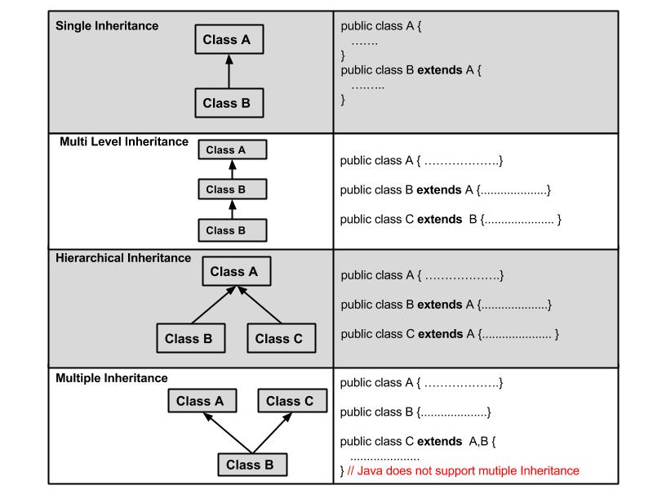
Types of Inheritance

Slide 8
Method(Function) Overriding
In object-oriented terms, overriding means to override the functionality of an existing method(function).
Method overriding is used to provide the specific implementation of the method that is already provided by its super class.
In a class hierarchy, when a method in a subclass has the same name and type signature as a method in its superclass, then the method in the subclass is said to override the method in the superclass.

Slide 9
Method(Function) Overriding
Method overriding occurs in two classes that have IS-A (inheritance) relationship.
Method overriding is the example of run time polymorphism.
A method declared final cannot be overridden.
A method declared static cannot be overridden.

Slide 10
Example-1
class Animal{
public void move() {
System.out.println("Animals can move");
}
}
class Dog extends Animal {
public void move(){
System.out.println("Dogs can walk and run");
}
}
public class TestDog {
public static void main(String args[ ])
{
Animal a = new Animal(); // Animal reference and object
Animal b = new Dog(); or Animal b; Dog d = new Dog(); b=d; // Animal reference but Dog object
a.move(); // runs the method in Animal class
b.move(); //Runs the method in Dog class
}
}
// a superclass reference variable can refer to a subclass object.

Slide 11
Polymorphism
Polymorphism is the ability of an object to take on many forms.
The most common use of polymorphism in OOP occurs when a parent class reference is used to refer to a child class object.

Slide 12
Polymorphism
It is important to know that the only possible way to access an object is through a reference variable. A reference variable can be of only one type. Once declared, the type of a reference variable cannot be changed.
The reference variable can be reassigned to other objects provided that it is not declared final. The type of the reference variable would determine the methods that it can invoke on the object.

Slide 13
Dynamic method dispatch
Dynamic method dispatch is the mechanism
by which a call to an overridden method is resolved at run time, rather than compile time.
Dynamic method dispatch is important because this is how Java implements run-time
polymorphism.

Slide 14
Dynamic method dispatch
When an overridden method is called through a superclass reference, Java determines which version of that method to execute based upon the type of the object being referred to at the time the call occurs.
Go t previous Example-1.

Slide 15
Abstract Classes
Sometimes if you want to create a superclass that only defines a generalized form that will be shared by all of its subclasses, leaving it to each subclass to fill in the details. Such a class determines the nature of the methods that the subclasses must implement.

Slide 16
Abstract Classes
Definition: A class that is declared as abstract is known as abstract class. It needs to be extended and its method implemented. It cannot be instantiated.
Abstract method : A method that is declared as abstract and does not have implementation is known as abstract method.

Slide 17
Example -2
abstract class Bike {
abstract void run();
}
class Honda extends Bike {
void run() { System.out.println ("running safely.."); }
public static void main(String args [ ]) {
Bike obj = new Honda();
obj.run();
}
}

Slide 18
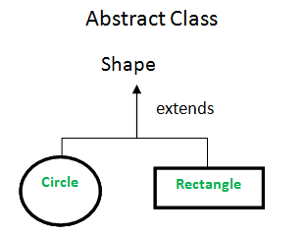
Real scenario of abstract class
Shape is the abstract class, its implementation is provided by the Rectangle and Circle classes

Slide 19
Example-3
abstract class Shape{
abstract void draw();
}
//In real scenario, implementation is provided by others i.e.
unknown by end user
class Rectangle extends Shape {
void draw(){ System.out.println("drawing rectangle"); }
}
class Circle1 extends Shape{
void draw(){ System.out.println("drawing circle"); }
}

Slide 20
Interfaces
Interfaces are syntactically similar to classes, but they lack instance variables, and their methods are declared without any body.
In practice, this means that you can define interfaces that don’t make assumptions about how they are implemented.
Once it is defined, any number of classes can implement an interface. Also, one class can implement any number of interfaces.

Slide 21
Interface
cannot instantiate an interface.
An interface does not contain any constructors.
All of the methods in an interface are abstract.
The only fields that can appear in an interface must be declared both static and final.
An interface is not extended by a class; it is implemented by a class.
An interface can extend multiple interfaces.

Slide 22
Abstract class vs Interface
Type of methods: Interface can have only abstract methods. Abstract class can have abstract and non-abstract methods. From Java 8, it can have default and static methods also.
Final Variables: Variables declared in a Java interface are by default final. An abstract class may contain non-final variables.
Type of variables: Abstract class can have final, non-final, static and non-static variables. Interface has only static and final variables.
Implementation: Abstract class can provide the implementation of interface. Interface can’t provide the implementation of abstract class.
Inheritance vs Abstraction: A Java interface can be implemented using keyword “implements” and abstract class can be extended using keyword “extends”.
Multiple implementation: An interface can extend another Java interface only, an abstract class can extend another Java class and implement multiple Java interfaces.
Accessibility of Data Members: Members of a Java interface are public by default. A Java abstract class can have class members like private, protected, etc.

Slide 23
Implementing Interfaces
Once an interface has been defined, one or more classes can implement that interface.
To implement an interface, include the implements clause in a class definition, and then create the methods defined by the interface.
e.g., class Client implements employee

Slide 24
Using final with Inheritance
The keyword final has three uses:
It can be used as a constant variable.
Use final to Prevent Overriding.
Use final to Prevent Inheritance

Slide 25
Use final to Prevent Overriding
class A {
final void meth() {
System.out.println("This is a final method.");
}
}
class B extends A {
void meth() { // ERROR! Can't override.
System.out.println("Illegal!");
}
}

Slide 26
Use final to Prevent Inheritance
final class A {
// ...
}
// The following class is illegal.
class B extends A { // ERROR! Can't subclass A
// ...
}

Slide 27
The Object Class
There is one special class, Object, defined by Java.
All other classes are subclasses of Object.
This means that a reference variable of type
Object can refer to an object of any other class. Also, since arrays are implemented as classes, a variable of type Object can also refer to any array.

Slide 28
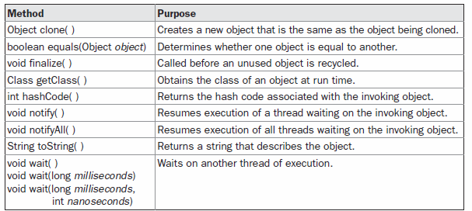
The Object Class

Slide 29
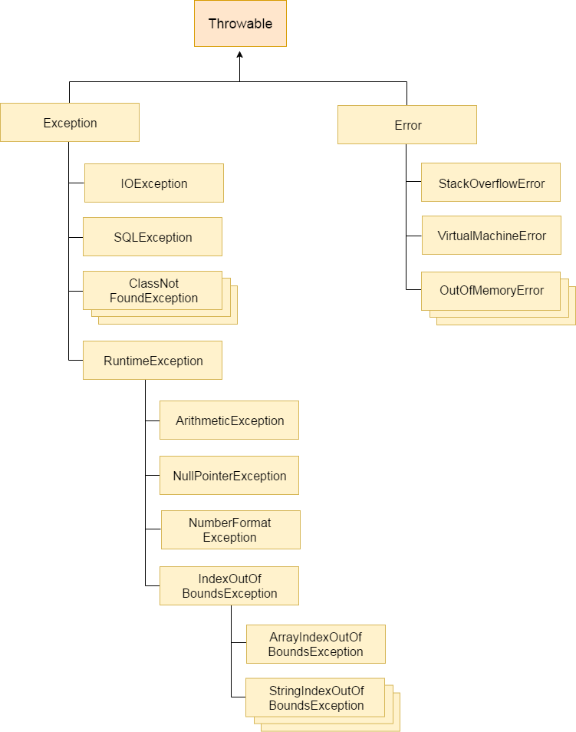
Exception handling: The exception handling in java is one of the powerful mechanism to handle the runtime errors so that normal flow of the application can be maintained.

Slide 30
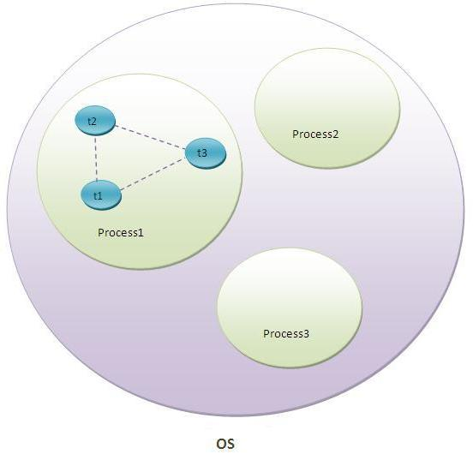
Thread
Thread is basically a lightweight sub-process, a smallest unit of processing. Multiprocessing and multithreading, both are used to achieve multitasking

Slide 31
Multithreading
A multithreaded program contains two or more parts that can run concurrently.
Each part of such a program is called a thread, and each thread defines a separate path of execution.
Thus, multithreading is a specialized form of multitasking

Slide 32
Multithreading
Multithreading in java is a process of executing multiple threads simultaneously.
But we use multithreading than multiprocessing:
because threads share a common memory area. They don't allocate separate memory area so saves memory.
context-switching between the threads takes less time than process.
Inter-process communication is expensive and limited.

Slide 33
Advantage of Java Multithreading
It doesn't block the user because threads are independent and you can perform multiple operations at same time.
You can perform many operations together so it saves time.
Threads are independent so it doesn't affect other threads if exception occur in a single thread

Slide 34
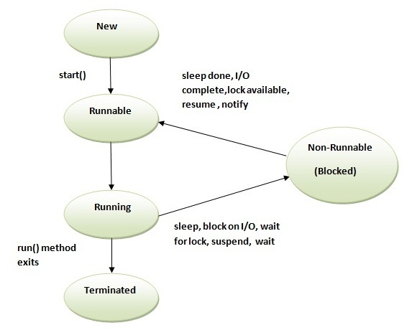
Life cycle of a Thread

Slide 35
Priority of a Thread
Each thread have a priority. Priorities are represented by a number between 1 and 10.
3 constants defiend in Thread class:
public static int MIN_PRIORITY
public static int NORM_PRIORITY
public static int MAX_PRIORITY
Default priority of a thread is 5. (NORM_PRIORITY). The value of MIN_PRIORITY is 1 and the value of MAX_PRIORITY is 10.

Slide 36
Priority of a Thread
public int getPriority(): returns the priority of the thread.
public int setPriority(int priority): changes the priority of the thread.

Slide 37
Thread Priority Example
class TestMultiPriority1 extends Thread{
public void run(){
System.out.println("running thread name is:"+Thread.currentThread().getName());
System.out.println("running thread priority is:"+Thread.currentThread().getPriority());
}
public static void main(String args[]){
TestMultiPriority1 m1=new TestMultiPriority1();
TestMultiPriority1 m2=new TestMultiPriority1();
m1.setPriority(Thread.MIN_PRIORITY);
m2.setPriority(Thread.MAX_PRIORITY);
m1.start();
m2.start();
}
}
Output: running thread name is:Thread-0 running thread priority is:10 running thread name is:Thread-1 running thread priority is:1

Slide 38
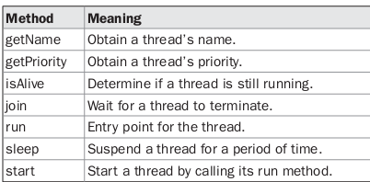
The Thread Class and the Runnable Interface
Java’s multithreading system is built upon the Thread class and its companion interface, Runnable.
The Thread class defines several methods that help manage threads.

Slide 39
The Main Thread
When a Java program starts up, one thread begins running immediately. This is usually
called the main thread of your program, because it is the one that is executed when program begins.
- currentThread( ) method is used to control the main thread.
It is a public static member of Thread.
static Thread currentThread()

Slide 40
Example
// Controlling the main Thread.
class CurrentThreadDemo {
public static void main(String args[ ]) {
Thread t = Thread.currentThread();
System.out.println("Current thread: " + t);
// change the name of the thread
t.setName("My Thread");
System.out.println("After name change: " + t);
try {
for(int n = 5; n > 0; n--) {
System.out.println(n);
Thread.sleep(1000);
}
}
catch (InterruptedException e)
{
System.out.println("Main thread interrupted");
}
}
}

Slide 41
Creating a Thread
Create a thread by instantiating an object of type Thread.
Java defines two ways in which this can be accomplished:
You can extend the Thread class.
You can implement the Runnable interface.

Slide 42
Java Thread Example by extending Thread class
class Multi extends Thread{
public void run(){
System.out.println("thread is running...");
}
public static void main(String args[]){
Multi t1=new Multi();
t1.start();
}
}

Slide 43
Example
// Java code for thread creation by extending
// the Thread class
class MultithreadingDemo extends Thread
{
public void run()
{
try
{
// Displaying the thread that is running
System.out.println ("Thread " +
Thread.currentThread().getId() +
" is running");
}
catch (Exception e)
{
// Throwing an exception
System.out.println ("Exception is caught");
}
}
}

Slide 44
// Main Class
public class Multithread
{
public static void main(String[] args)
{
int n = 8; // Number of threads
for (int i=0; i<8; i++)
{
MultithreadingDemo object = new MultithreadingDemo();
object.start();
}
}
}

Slide 45
Runnable Interface for Createating Thread
The easiest way to create a thread is to create a class that implements the Runnable interface.
Runnable abstracts a unit of executable code.
To implement Runnable, need basic three steps:
called run( ),
public void run( )
- This method provides entry point for the thread and you will put you complete business logic inside this method.

Slide 46
Runnable Interface
At second step you will instantiate a Thread object using the following constructor:
Thread (Runnable threadObj, String threadName); Where,
threadObj is an instance of a class that implements the Runnable interface and threadName is the name given to the new thread.
At third step Once Thread object is created, starts it by calling start( ) method, which executes a call to run( ) method.

Slide 47
Example
class Multi implements Runnable{
public void run(){
System.out.println("thread is running...");
}
public static void main(String args[]){
Multi m1=new Multi();
Thread t1 =new Thread(m1,”first”);
t1.start();
}
}

Slide 48
Synchronization in Java
Concurrent access to shared resources, data may result in data inconsistency.
Maintaining consistency requires mechanism to ensure the orderly execution of cooperating threads or processes.

Slide 49
Synchronization in Java
Synchronization in java is the capability to control the access of multiple threads to any shared resource.
Java Synchronization is better option where we want to allow only one thread to access the shared resource (Critical Section).

Slide 50
Synchronization in Java
For example, in a database system, you might not want one thread to be updating a database record while another thread is trying to read it at a same time.
Java enables you to coordinate the actions of multiple threads using
synchronized methods and
synchronized statements.

Slide 51
Inter-thread communication
Inter-thread communication is all about allowing threads to communicate with each other.
Inter-thread communication is a mechanism in which a thread is paused running in its critical section and another thread is allowed to enter (or lock) in the same critical section to be executed.
It is implemented by following methods of Object class:
wait()
notify()
notifyAll()

Slide 52
wait() method
Causes current thread to release the lock and wait until either another thread invokes the notify() method or the notifyAll() method for this object, or a specified amount of time has elapsed.
The current thread must own this object's monitor, so it must be called from the synchronized method only otherwise it will throw exception.
Syntax: public final void wait()
throws InterruptedException

Slide 53
notify() method
Wakes up a single thread that is waiting on this object's monitor. If any threads are waiting on this object, one of them is chosen to be awakened.
Syntax: public final void notify()

Slide 54
notifyAll() method
Wakes up all threads that are waiting on this object's monitor. Syntax:
public final void notifyAll()

Slide 55
I/O Basics
(Java’s most important packages: io)

Slide 56
Streams
A stream is an abstraction that either produces or consumes information.
A stream is linked to a physical device by the Java I/O system.
NOTE: All streams behave in the same manner, even if the actual physical devices to which they are linked differ. Thus, the same I/O classes and methods can be applied to any type of device.

Slide 57
Types of streams
Two types:
- Byte and Character.
Byte streams provide a convenient means for handling input and output of bytes. Byte streams are used, for example, when reading or writing binary data.
Character streams provide a convenient means for handling input and output of characters. They use Unicode.

Slide 58
Reading Console Input
The following based on the requirement:
Scanner class
Buffered Reader and InputStreamReader classes
DataInputStream class
Console class

Slide 59
Reading Console Input
import java.util.Scanner;
class GetInput{
Main(){
int a;
String s;
Scanner in = new Scanner(System.in);
System.out.println("Enter a string");
s = in.nextLine();
System.out.println("You entered string " + s);
System.out.println("Enter an integer");
a = in.nextInt();
System.out.println("You entered integer " + a);
}
}

Slide 60
Reading Console Input
System.in
InputStreamReader
BufferedReader
InputStreamReader and BufferedReader are classes in java.io package.
The data is received in the form of bytes from the keyboard by System.in which is an InputStream object.
Then the InputStreamReader reads bytes and decodes them into characters.
Then finally BufferedReader object reads text from a character-input stream, buffering characters so as to provide for the efficient reading of characters, arrays, and lines.

Slide 61
Reading Console Input
InputStreamReader inp = new InputStreamReader(system.in); BufferedReader br = new BufferedReader(inp);
int i = Integer.parseInt(br.readLine());

Slide 62
Reading Console Input
To read a character from a BufferedReader, use read( ).
int read( ) throws IOException
To read a string from the keyboard, use the version of readLine( ) that is a member of the
BufferedReader class.

Slide 63
Reading Console Input
using DataInputStream class:
DataInputStream dis = new DataInputStream(System.in);
int i = dis.readInt();
using Console class: import java.io.Console;
Console c = System.console();
System.out.println("Enter your name: ");
String n = c.readLine();
System.out.println("Welcome "+n);

Slide 64
Writing Console Output
Console output is most easily accomplished with print( ) and println( ).
The printf( ) method automatically uses Formatter to create a formatted string.
The printf( ) method is defined by both PrintStream and PrintWriter class.
System.out.printf("Default floating-point format: %f\n", 12.3);

